Slide 1
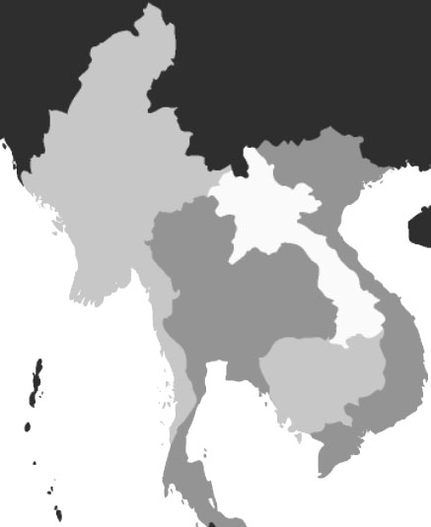
Water Security and Development in the Mekong River Basin: Old Dreams, New Dangers
Prepared for Teaching Water Workshop
Harvard University
August 5-8, 2013
Richard Cronin
Zachary Dubel
Stimson Center
Washington, D.C.

Slide 2
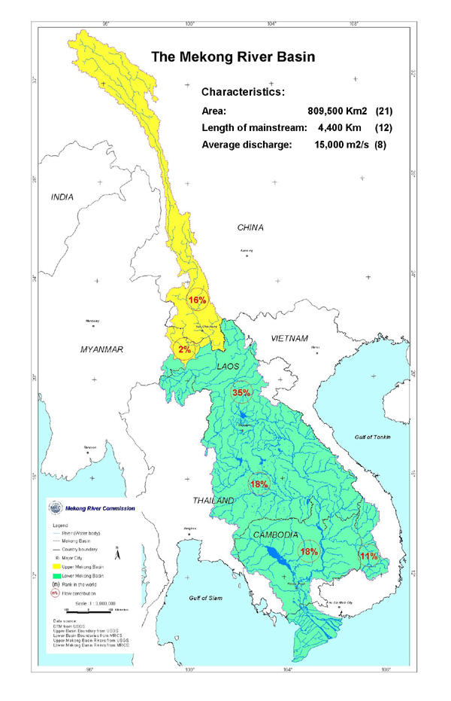
Mekong River Tibet to South China Sea
Source:
UNESCO and Mekong River Commission

Slide 3
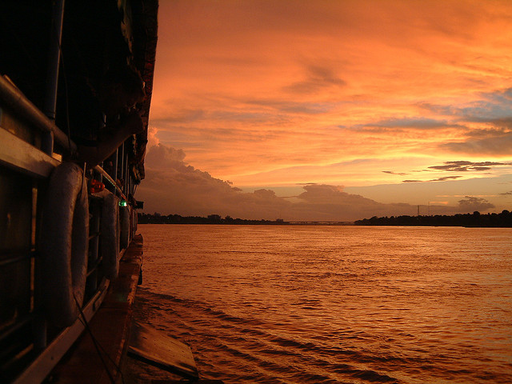
Lower Mekong
Basin (South of China Border)
Source:
Mekong River Commission, 1999

Slide 4
Mekong Characteristics
4,900 km River Shared by China and Five Southeast Asian Countries (MRC--Estimates Vary)
Rises in Tibet, China Controls Upper Half
Ecology Adapted to Extremes of Wet and Dry, Monsoon “Flood Pulse”
Main Source of Food Security and Livelihoods for Millions, Mainly in Lower Half
  Cambodia—60-80 Percent of Total Animal Protein
  Vietnam’s Mekong Delta—50% of Rice Crop, 16% of GDP

Slide 5
Old Dreams, New Dangers
Old Dreams—
  “River Road to China” (France)
  “Mekong Committee” (Cold War Era Plan for a Giant TVA Project to Stave off Communism)
New Dangers—
  Unavoidable Water-Food Security-Energy Tradeoffs
  Climate Change
Development of Transboundary River Threatens Regional Peace and Stability
Uncoordinated commercial opportunity projects for up to 11 Dams on Lao, Lao-Thai and Cambodian Stretches of Mainstream

Slide 6
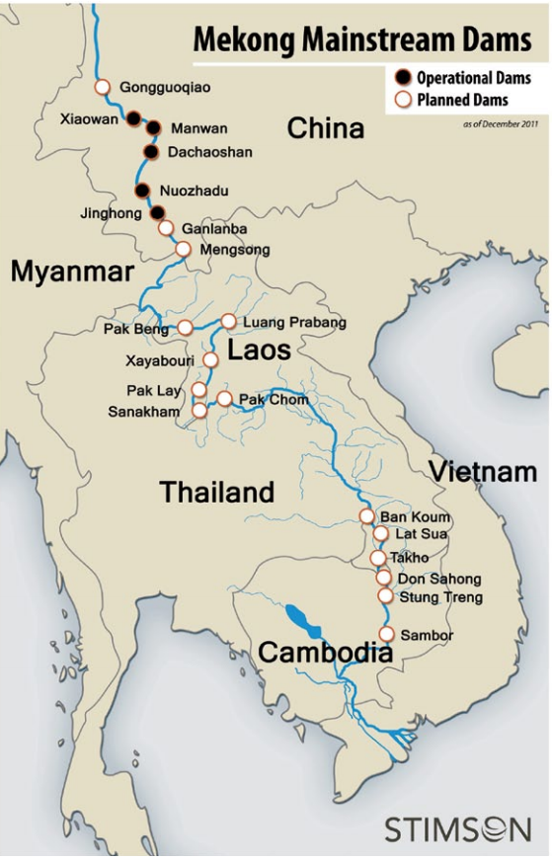
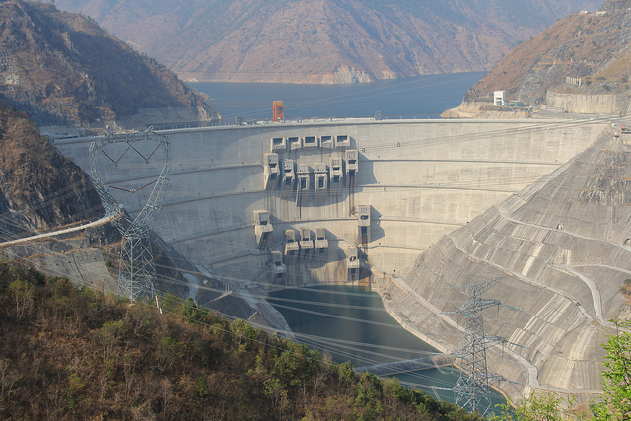
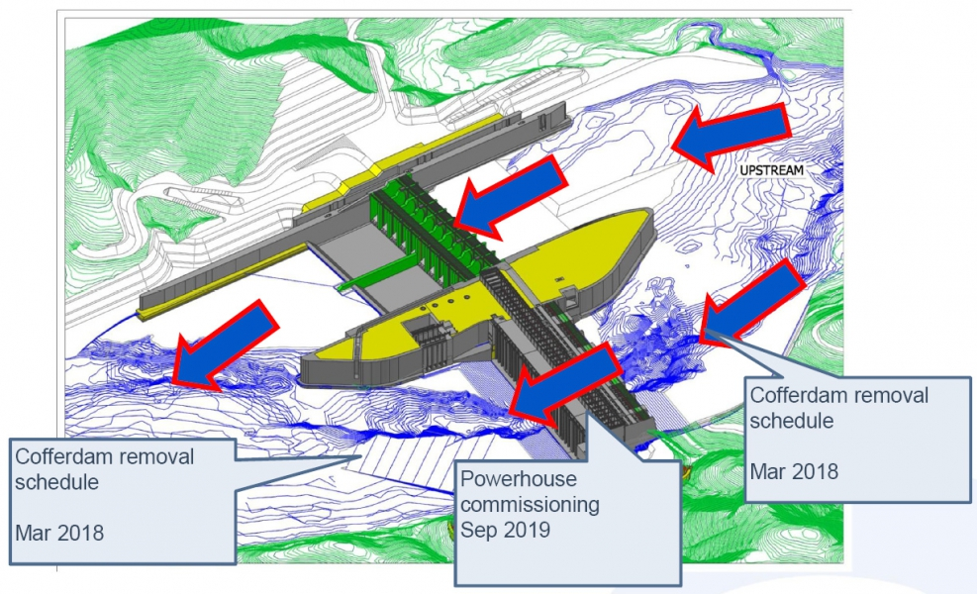
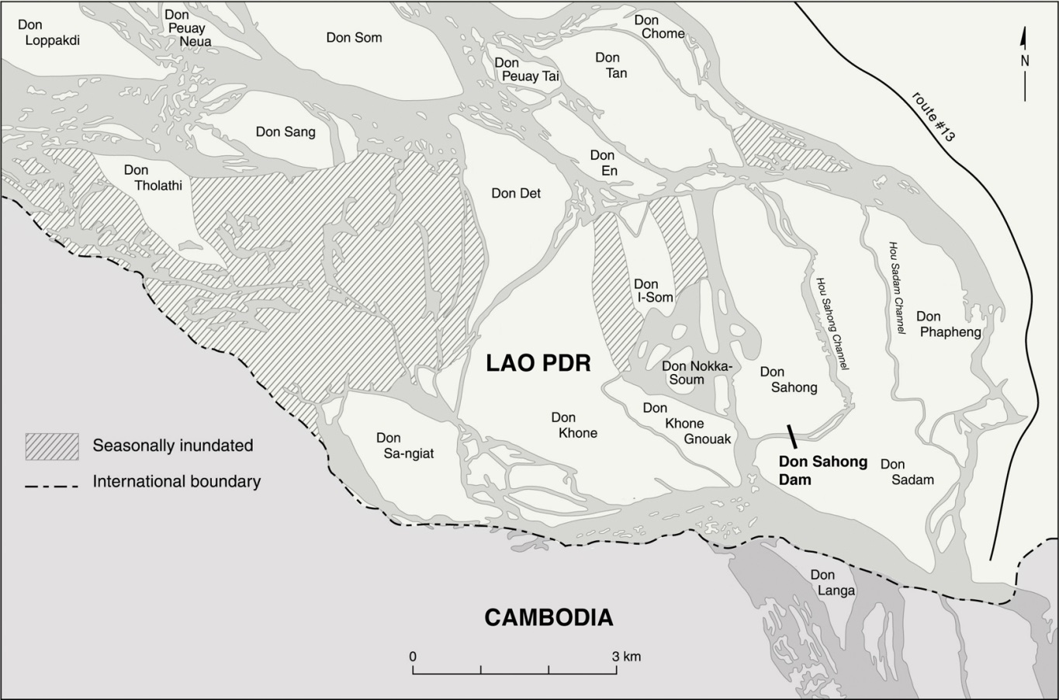
Xayaburi Dam
Xiaowan Dam
Don Sahong Site
Photo Source: International Rivers

Slide 7
The China Factor
Controls Upper Half of the River in Tibet and Yunnan, Which it Calls the Láncāng Jiāng ("Turbulent River”)
Treats as a National River with No Obligation to Downstream Neighbors
Hydro Potential Comparable to Three Gorges
Massive Reservoirs Enabler of Lower Mekong Projects by Regulating River Flow Between Seasons

Slide 8
Lower Mekong Basin
1995 Treaty Established 4-Country Mekong River Commission (MRC)
  Cambodia, Laos, Thailand and Vietnam
  Myanmar, China “Observers”
  Procedures for Notification, Prior Consultation and Agreement on Mainstream Dams, but No Veto)
11 Dams Under Construction, Planning or Active Feasibility Studies
  Laos (7, 1st Now Under Construction at Xayburi)
  Lao-Thai (2 on Shared Section of River)
  Cambodia (2)

Slide 9
Proposed Projects in Yunnan and the Lower Mekong
Source: MRC SEA of Mekong Hydropower

Slide 10
High Risks and Uncertainties
Severe Impact on Hydrological Cycle, Silt Transfer, Spawning Migration, & Agriculture
Financial Viability Depends on China to Release Stored Water During Dry Season
Serious Uncertainties—Climate Change, China’s Growing Water Shortage and its Refusal to Share Data
Major Threat to Future of MRC & Treaty Commitment to Cooperative Water Management

Slide 11
Example of Risks: Laos’ Xayaburi Dam
32-Meter High, 1,285 MW “Run-of-River” Dam Touted as “Transparent” but no Transboundary Environmental Impact Assessment to Validate
First Failed Test of MRC’s Review Protocol
Going Ahead Despite Lack of “Acceptance” by Neighbors
Regional Tensions High, Issues Unresolved
How Laos Handles Next Projects May Make or Break MRC & Cooperative Water Development

Slide 12
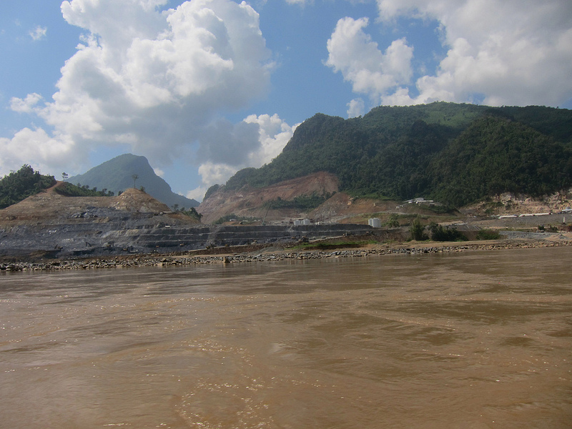
The Xayaburi Dam Site (October 2012)
Source: International Rivers

Slide 13
Source: MRC SEA of Mekong Hydropower

Slide 14
Some Possible Goals
  Initiate Necessary Studies to Optimize Regional Approach and Identify Best Dam Locations
  Focus Dam Construction as High Up Mainstream as Possible (Least Impact on Fisheries)
  Regional Conservation Measures to Reduce Demand—Especially Thailand, the Largest Electrical Consumer Country in the LMB
  Reconcile Competing National Interests via Shared Subregional Power Grid

Slide 15
Political Obstacles to Cooperation
Differing Perceptions of National Interests
  Laos: Revenue Focused—“Battery of Southeast Asia”
  Thailand—Energy Diversification/Structural Incentives for State Electrical Utility to Over Invest
  Cambodia—Inadequate/High Cost Thermal Power
  Vietnam—Concerns About Delta but Also Fast Growing Power Demand
Transboundary “Winners” and “Losers”
Powerful stakeholder interests
Endemic Corruption

Slide 16
Last Chance to Avoid Catastrophe
Laos Must Follow MRC’s PNPCA Protocol for All New Projects
Highest Level Political Engagement on An Agreed “Mekong Standard” for Maximum Acceptable Transboundary Impact
Engagement by Multilateral Banks, US and other Donors to Support Regional Electrical Grid
Objective: Fewest Dams in Least Destructive Places

Slide 17
Concluding Thoughts
Two Dominant Realities—Transboundary River and “Iron Law” of Water-Food-Energy Nexus
Scientifically and Politically Realistic Tradeoffs Required to Minimize “Winners” and “Losers”
“Sustainable Development” – Yes; “Sustainable Poverty” - No Longer Acceptable
Cooperation and Equity Under MRC or Other International Framework for Regional Harmony
Political Will Essential
What Goes Around Comes Around—Every Country Has a Stake

Slide 18

rcronin@stimson.org zdubel@stimson.org
Thank You!

